Slide 1
REAL-TIME ENERGY CONSUMPTION MONITORING USING AI BASED NILM SYSTEM (P2123)
Supervisor
Engr. Umer Farooq
Co-Supervisor
Dr. Hafiz Zia Ur Rehman
Members
Muhammad Salman (211291)
Muhammad Mahmood Ghauri (211265)
Muhammad Moin Dildar (211201)

Slide 2
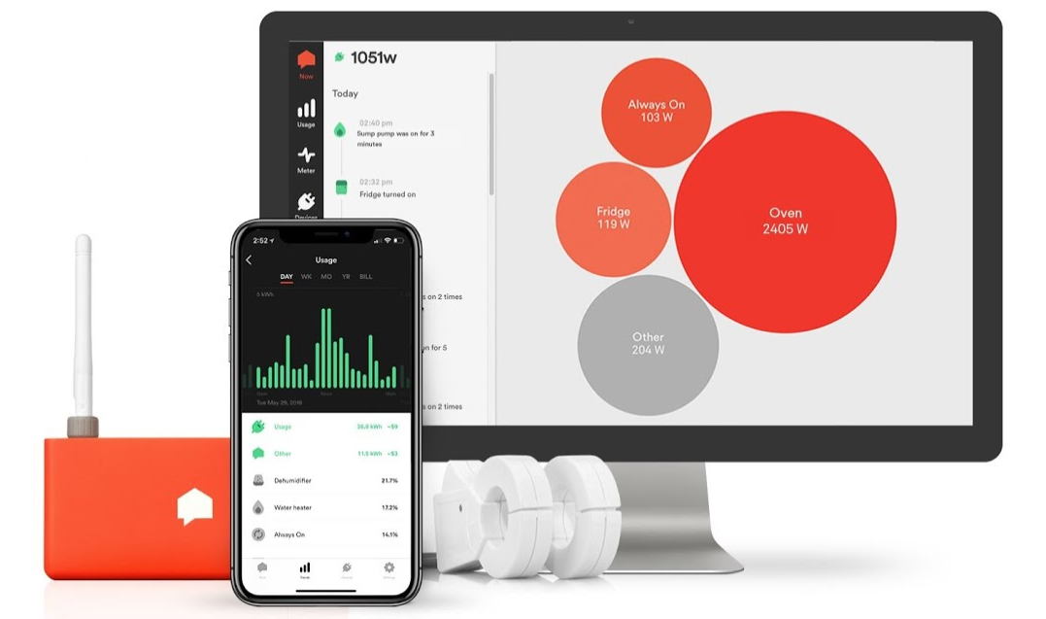
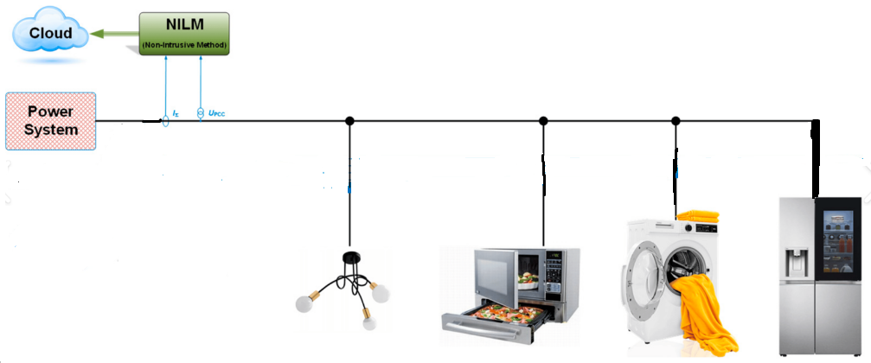
Introduction
The AI-based NILM system is designed to offer real-time energy consumption monitoring for residential and commercial buildings. It leverages advanced AI algorithms and data analytics to detect and forecast the energy usage patterns of individual appliances.

Slide 3
Objective
Identifying the energy consumption of individual device from the selected group of daily use household appliances.
Real time data collection ( stored on server) and analyze to predict the possible power consumption by a specific appliance.
Implementing AI algorithm in Microcontroller.

Slide 4
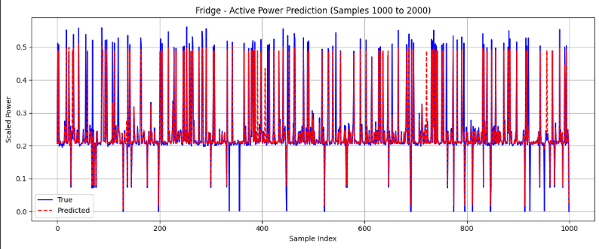
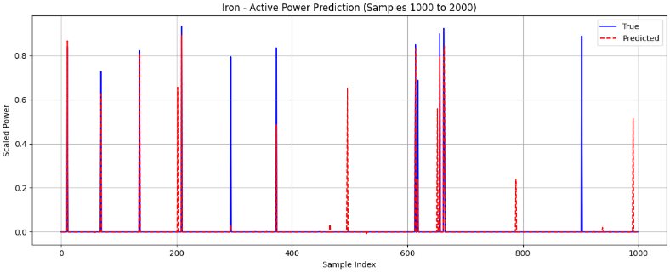
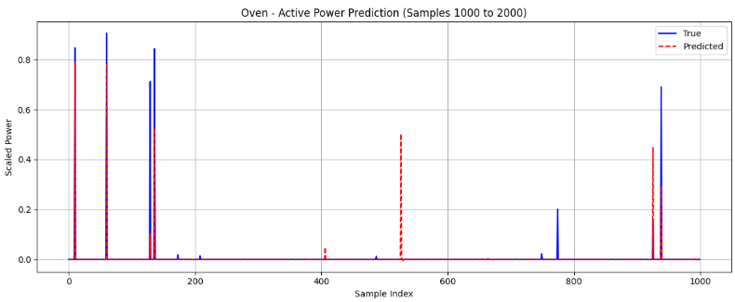
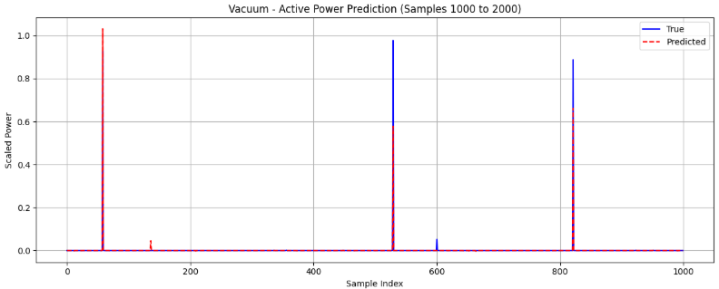
Model Results
‘

Slide 5
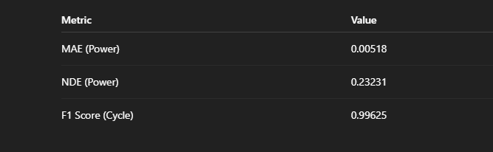
Evaluation Metrices
.

Slide 6
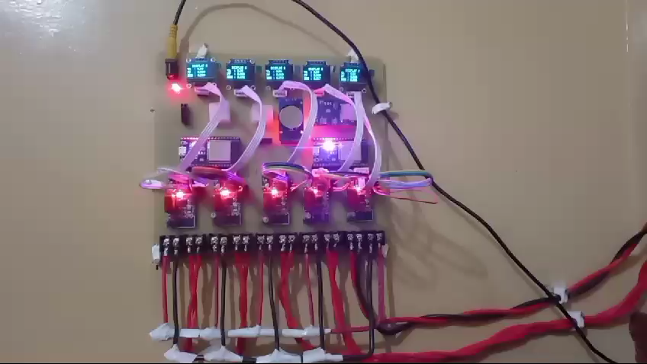
Data Collection

Slide 7
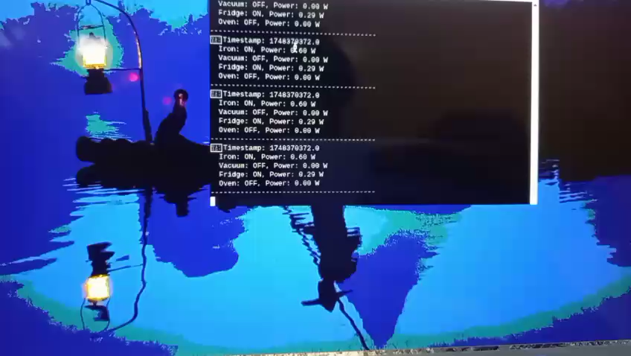
Real-Time NILM System using AI Algorithm

